Slide 1
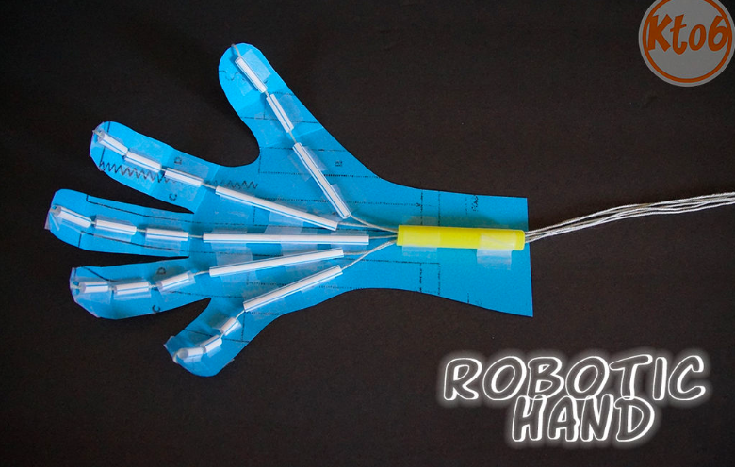
Wednesday: Make a Robotic Hand
Challenge: Students are to design and construct a bionic hand that is able to catch a soft foam ball.
Where: In the hall
When: At lunch (after eating).
Note: this is a fiddly project for younger students – they may need to ask for help!

Slide 2
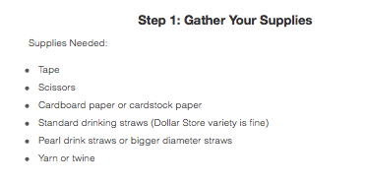

Slide 3
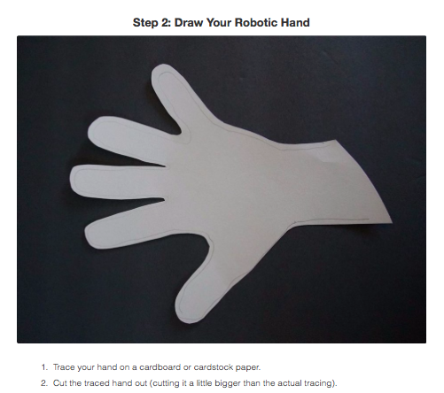

Slide 4
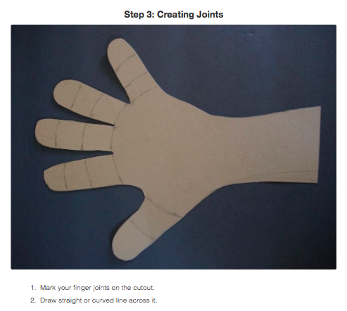

Slide 5
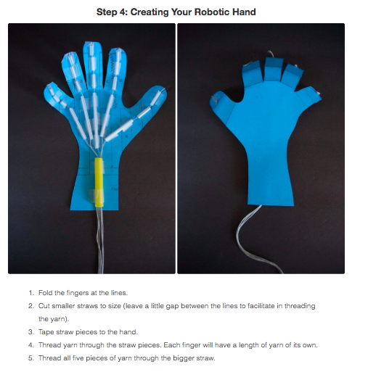

Slide 6
